Slide 1
AI-Based Network Intrusion & Suspicious Traffic Analyzer
~By Prem Bhatt

Slide 2
🟢 Problem Understanding & Planning
Problem
Network logs are complex and hard to understand
Traditional IDS tools give alerts without explanations
Small organizations/students lack easy tools
Goal
Detect suspicious network behavior
Explain attacks in simple language using AI
User input log-based analysis
AI-based explanation using Gemini

Slide 3
How it is unique from actual IDS?
IDS(Intrusion detection system) is much harder to understand
My project is unique and easier to understand because:
Detect DDoS attack, Port Scanning and Brute Force attacks
Provides AI-based explanations
Visualize network traffic patterns
Support fallback detection without AI
Doesn’t need high level knowledge to understand the attacks and logs

Slide 4
Software Requirments
🌐 Frontend Language
HTML
CSS
🧠 Backend
Python
Flask
Google Gemini Api
🗄️ Database
MongoDB (NoSQL)

Slide 5
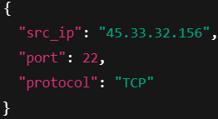

Existing System
• Raw logs difficult to understand
• Requires skilled SOC analysts
• Expensive SIEM solutions
• Limited visualization
Firewall network logs Json logs
This is example of firewall network logs
Our system can include a log normalization module that converts complex heterogeneous network logs into a simple unified JSON format for analysis.

Slide 6
Proposed System
AI-driven intrusion detection
Live traffic simulation
Automatic attack classification
Visual analytics dashboard
Ai based easy to understand explanation

Slide 7
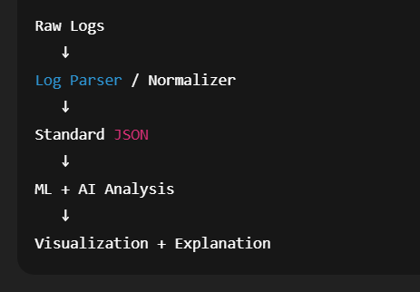
Working of System
Network logs are collected and converted into a standard JSON format.
The system analyzes logs using rules and machine learning to detect attacks.
Gemini AI explains the detected activity in simple language.
Fallback logic works if AI is unavailable.
Results are shown with attack type, risk level, and charts.

